Slide 1

http://flic.kr/p/7u4Xr2
Software Engineering Process

Slide 2
SWEBOK Knowledge Areas
Software Requirements
Software Design
Software Construction
Software Testing
Software Maintenance
Software Configuration Management
Software Engineering Management
Software Engineering Process
Software Engineering Models and Methods
Software Quality
Software Engineering Professional Practice
Software Engineering Economics
Computing Foundations
Mathematical Foundations
Engineering Foundations
Today’s topic

Slide 3

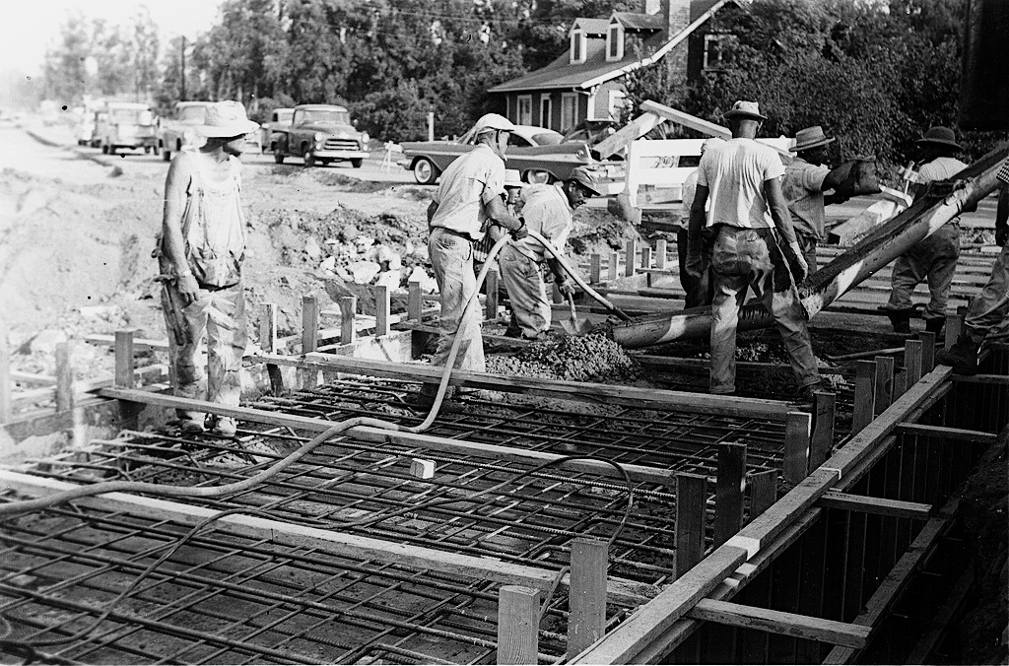
Engineering software is a big job
http://flic.kr/p/7GereG
http://flic.kr/p/5w9rXP
Variety of tasks:
Requirements
Design
Implementation
Verification (testing)
Maintenance

Slide 4
Practical issue: What order should tasks be done in?
That is, what process to use?

Slide 5
The classic way: Waterfall (sequential) model
Requirements
But often a bad way…
Design
Implementation
Verification
Maintenance
http://en.wikipedia.org/wiki/File:Waterfall_model_%281%29.svg
Notes:
60s and 70s-era advice

Slide 6
What could go wrong?
Requirements
6 months
Design
6 months
Implementation
3 months
Verification
6 months
Release!
http://en.wikipedia.org/wiki/File:Waterfall_model_%281%29.svg
Notes:
60s and 70s-era advice

Slide 7

What could go wrong?
Problem!
Requirements
6 months
Design
6 months
Implementation
I don’t like it…
3 months
Verification
6 months
Release!
Customer
http://en.wikipedia.org/wiki/File:Waterfall_model_%281%29.svg
Notes:
60s and 70s-era advice

Slide 8
Waterfall is often a poor practice
High failure rates
Low productivity
High defect rates
45% of features in requirements never used
Early schedule and estimates off by up to 400%

Slide 9
Why Waterfall doesn’t work
False assumption: Specifications …
are predictable and stable
can be correctly defined at the start
have low change rates
Actual stats:
25% of requirements changed
35% to 50% changed in large projects

Slide 10
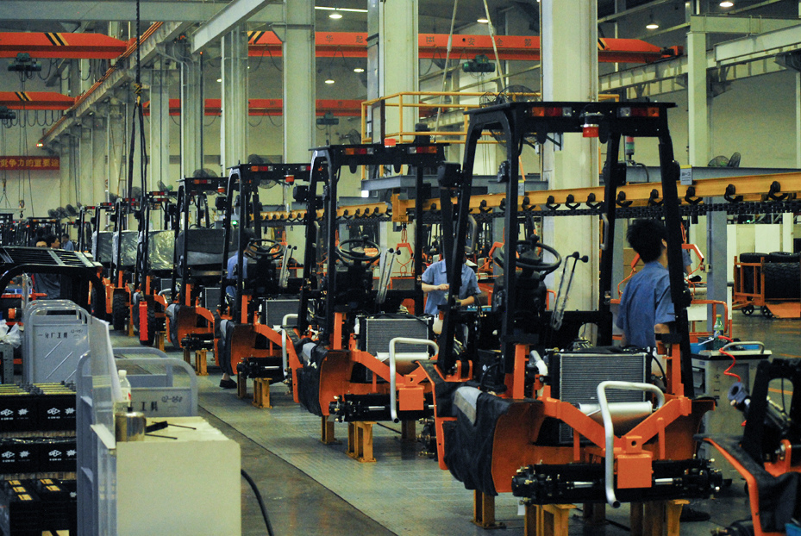
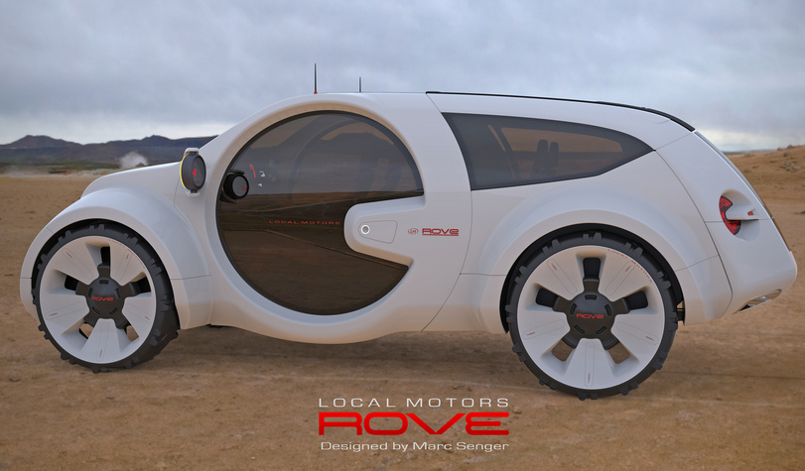
What is software engineering more like?
web app
web app
web app
web app
Mass manufacturing?
http://flic.kr/p/9xmccb
web app
New product development?
http://flic.kr/p/edV9JR
Notes:
Each machine that comes off the assembly line is like a piece of software. This is obviously a false analogy.

Slide 11
Waterfall is a “defined” process control model
(good for mass manufacturing)
http://flic.kr/p/9xmccb
Software devel. needs an “empirical” model
(good for new product development)
http://flic.kr/p/edV9JR
Notes:
Each machine that comes off the assembly line is like a piece of software. This is obviously a false analogy.

Slide 12
Basis of empirical process model…
Feedback
Adaptation

Slide 13
Iterative Development Process
Requirements
Analysis
Design
Initial Planning
Planning
Implementation
Testing
Evaluation
Deployment

Slide 14
Iterative Development Process
Requirements
Analysis
Design
Initial Planning
Planning
Implementation
Where are
feedback
&
adaptation?
Testing
Evaluation
Deployment

Slide 15
Iterative Development Process
Requirements
Analysis
Design
Initial Planning
Planning
Implementation
Adaptation
Feedback
Testing
Evaluation
Deployment

Slide 16
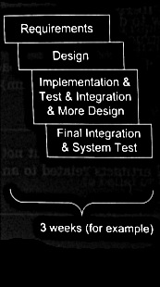
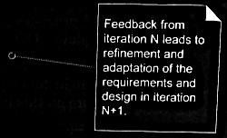
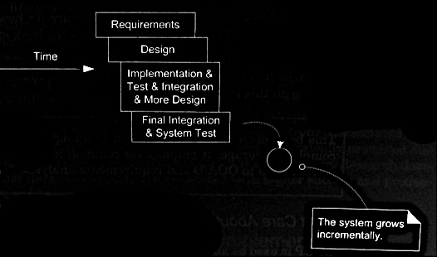
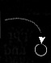
Iterative and incremental development
also called iterative and evolutionary
Larman Figure 2.1

Slide 17
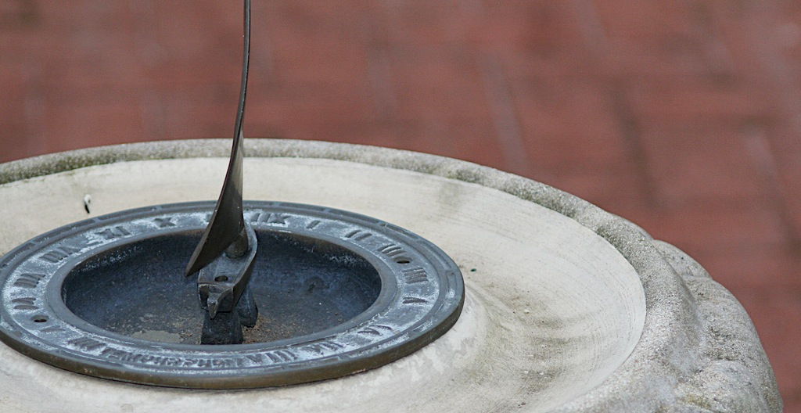
How long should iterations be?
Short is good
2 to 6 weeks
1 is too short to get meaningful feedback
Long iterations subvert the core motivation
http://flic.kr/p/368zW7

Slide 18

Iterative and incremental development addresses the “yes…but” problem
Yes, that’s what I asked for, but now that I try it, what I really need is something slightly different.

Slide 19
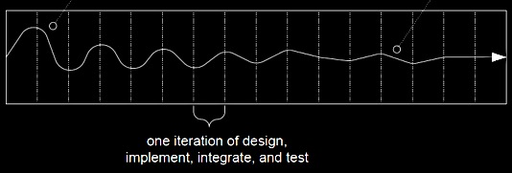
Requirements stabilize over time
Unstable requirements
Requirements more stable
Larman Figure 2.2

Slide 20
More benefits of iterative development
Fewer defects
Greater productivity
Early mitigation of risk
Early visible progress
Meet real needs of stakeholders
No “analysis paralysis”
Iterative process improvement

Slide 21

Summary
Software Engineering Process
Waterfall
Defined versus Empirical
Iterative and Incremental
http://flic.kr/p/aCLor3

